Slide 1
Name as many famous pieces of music as you can.

Slide 2
How does music help corporate and private worship? (linked very much to aid to prayer and worship)
=

Slide 3
Corporate
PRIVATE

Slide 4
Name as many famous pieces of music as you can.

Slide 5
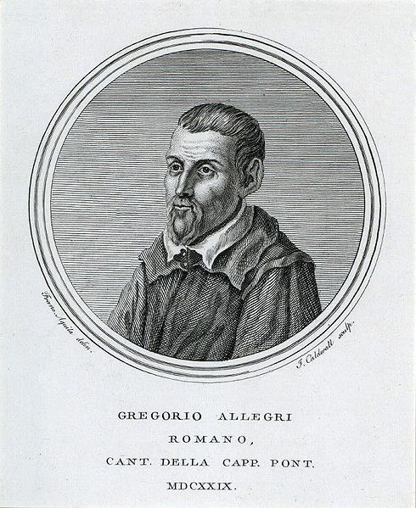
Possibly the most famous piece of religious church music Miserere Mei

Slide 6
How does it help? Did you like it? For a group or an individual?

Slide 7
For a group?
Advice: Listen to the words of what is sung. What does that tell you about the relationships these Christians want to develop with God?
Rock Choir – Reasoning for corporate worship?
Typical worship the Same as Rock Choir?
Reading the lyrics or believing the theology?
Was that an unfair example of the corporate?
The Justin Bieber of the Christian Music World
Corporate drowns out the private
Is listening more important than talking?

Slide 8
Can Christians access God through outward express or should you be listening for his message? | Is corporate worship solely important because it creates a sense of identity?
How do you combat the dangerous slope of merely repeating the words rather than listening to the message? | How do you know you are on the right track with private worship?

Slide 9
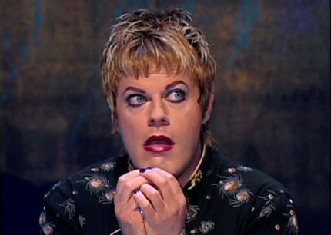
The unlikely theologian!

